Slide 1

Small Office Project
Created by Mikhalskiy Ivan

Slide 2

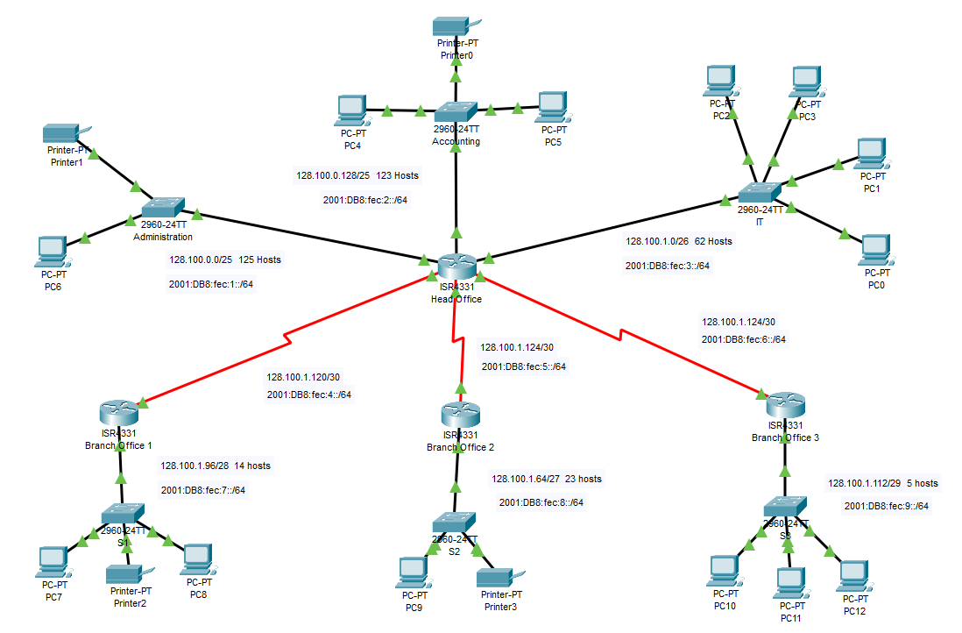
First Step
Created topology
I used the following components to create the topology:
4 Routers 4331
6 Switch 2960
13 PCs
4 Printers
23 Copper Straight-Through cable
3 Serial DTE cable

Slide 3
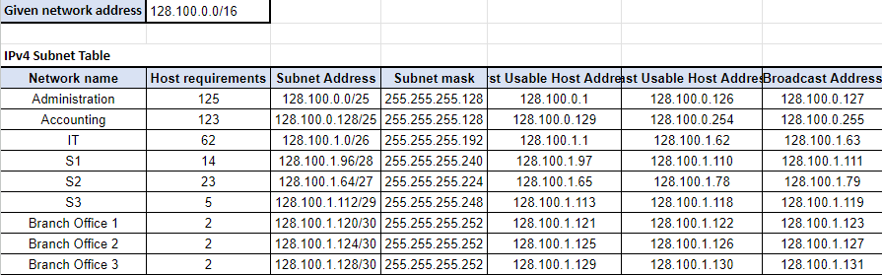
Second step
Distribute IPv4 using VLSM
Start assigning from the largest number of hosts
Calculate which subnet mask to use
Calculate the subnet address for each network, leaving 2 hosts to account for the network address and the broadcast address

Slide 4
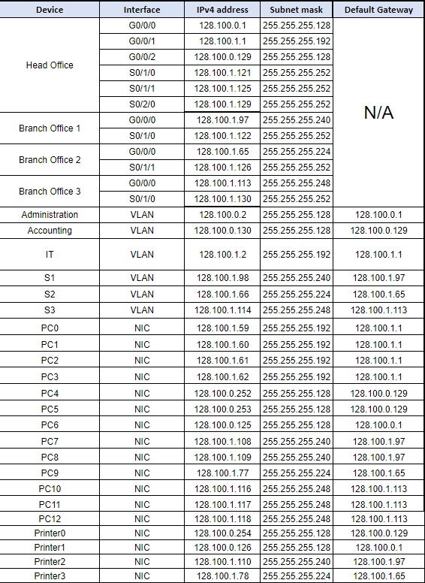
Second step
Distribute IPv4 using VLSM
Result:

Slide 5
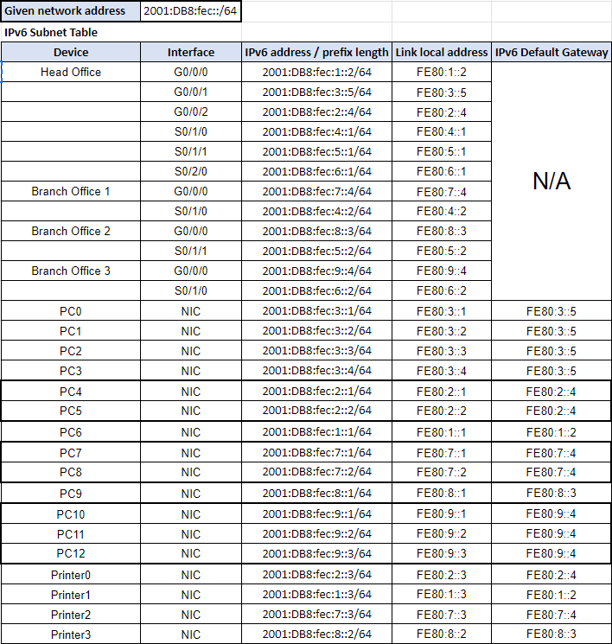
Third step
Distribute IPv6
Start distribution from PCs
Issue to WAN, separate IP addresses
Result:

Slide 6

Fourth step
Configuring routers and switches
By using the Hostname
Installing the banner during login
Minimum password length and password for EXEC mode
Turn off Domain-lookup (there is no DNS server) and set domain-name

Slide 7
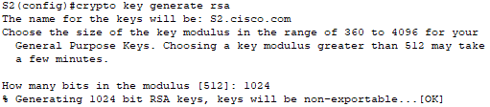
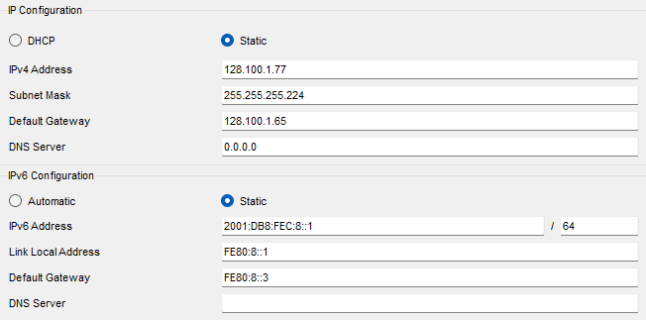
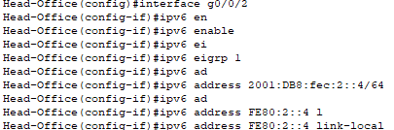

Fourth step
Configuring routers and switches
Set clock for all devices
Generate RSA key for remote connection
Create a EIGRP for to find neighbors
IP issuance for all connections

Slide 8
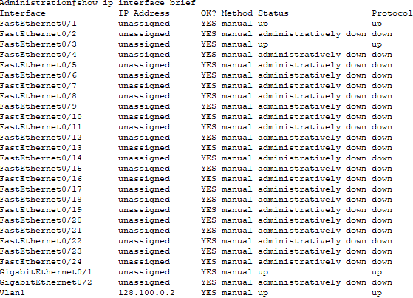
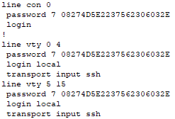
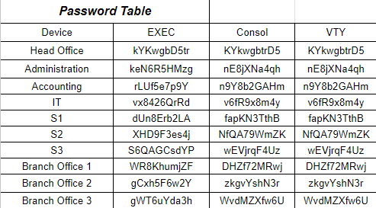
Fourth step
Configuring routers and switches
Turn off unused ports
Configure the console port and vty of SSH connection

Slide 9
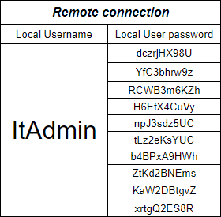
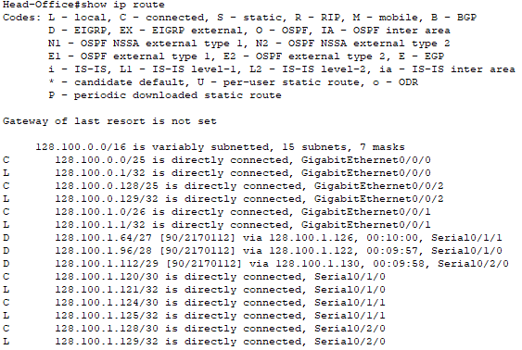
Fourth step
Configuring routers and switches
Create a user for secure SSH connection
Checking the connections

Slide 10
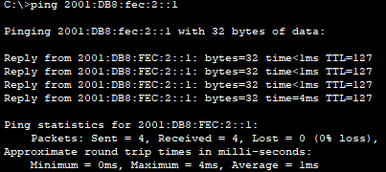
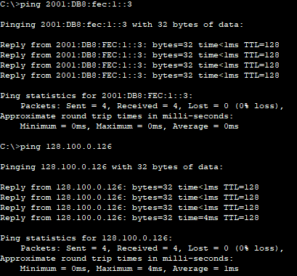
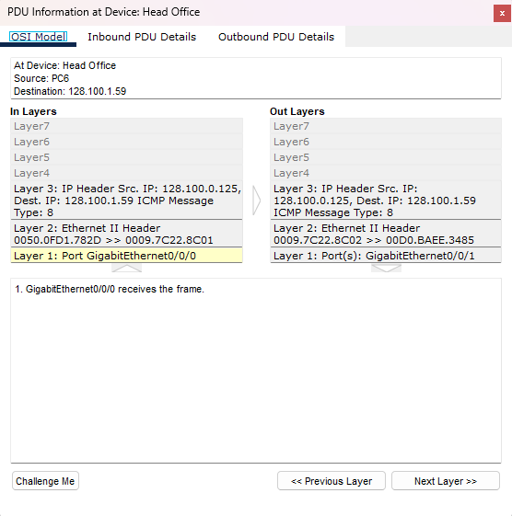
Fifth step
Check the performance
Check the ping command
Check ICMP packets and Layer

Slide 11
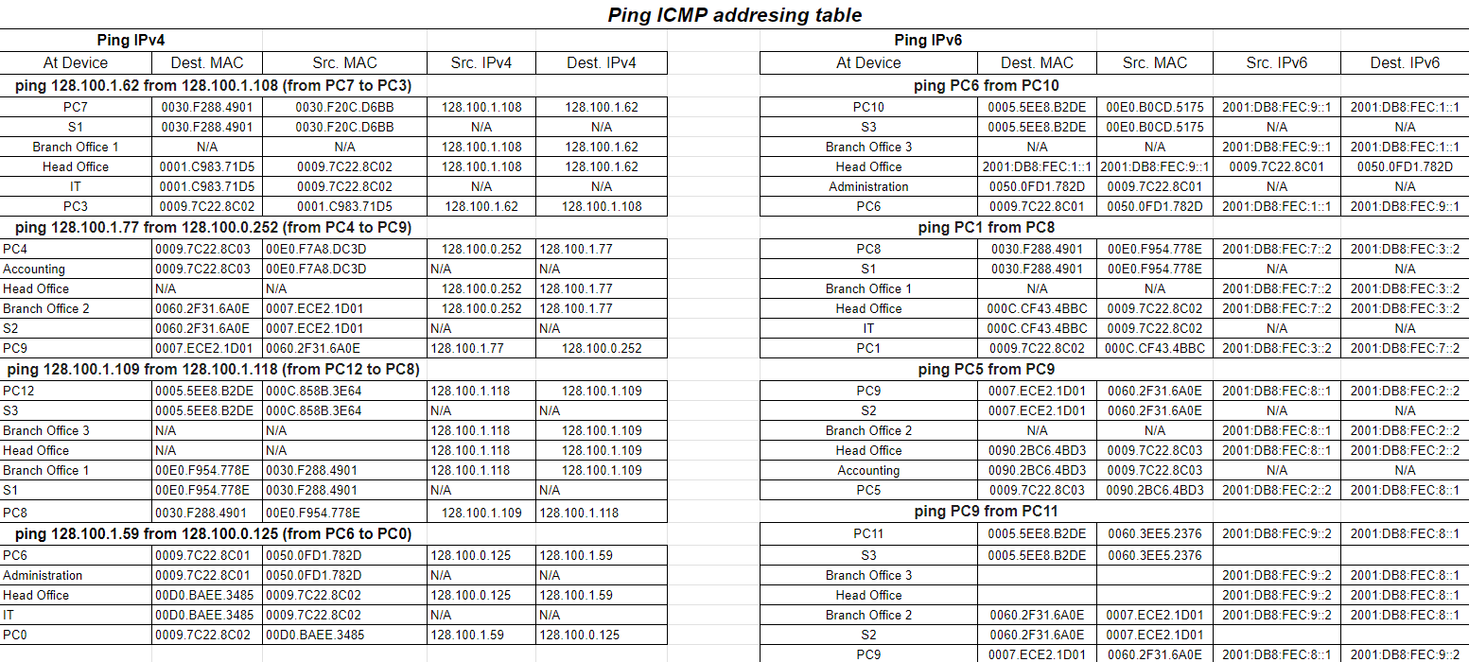
Fifth step
Check the performance
Created ICMP table

